Slide 1
Coptic Lesson 2
Coptic Letters that only look like English

Slide 2
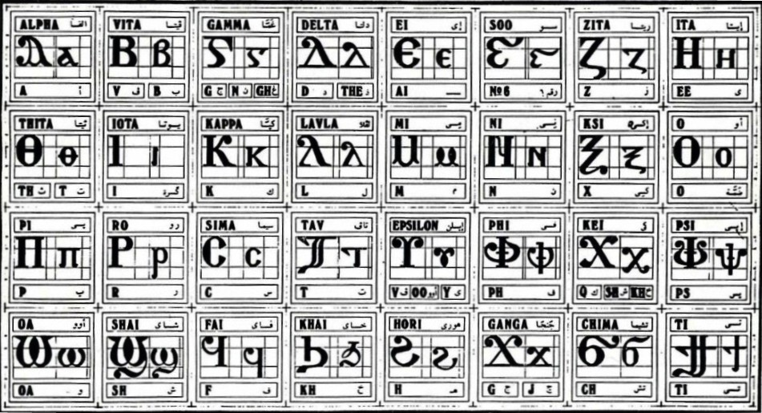
Coptic Alphabets

Slide 3
Letters that look like English
Y y = ee (Eeta)
R r = r (Ro)
< , = k, sh, kh (Kei)
D d = d, z (Delta)

Slide 4
Review
D Y R <
d y r ,
A B E Z I K M N O C T W
a b e z i k m n o c t w

Slide 5
Review Questions
d
d, z
Delta
r
r
Ro
T
t
Tav
w
oa
Omega
,
k, sh, kh
Kei
B
b or v
Vita
Y
ee
Eeta

Slide 6
Coptic Reading
,a ,e ,y ,i ,o ,w
da de dy di do dw
Ba be by bi bo bw
ra re ry ri ro rw
Ta te ty ti to tw
Ca ce cy ci co cw
Za ze zy zi zo zw

Slide 7
Coptic Alphabets

Slide 8
Announcement

Slide 9

Oujai qen `P[oic

